Slide 1
24v to Control Board Cable

Slide 2
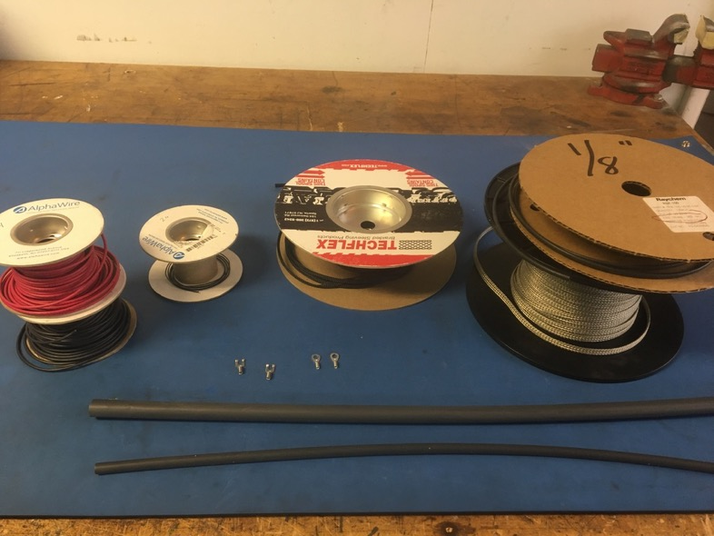
Materials

Slide 3
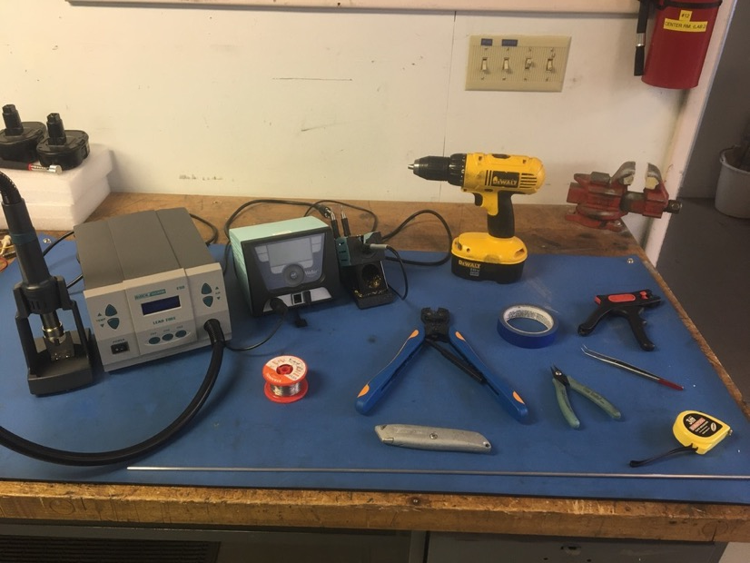
Tools

Slide 4
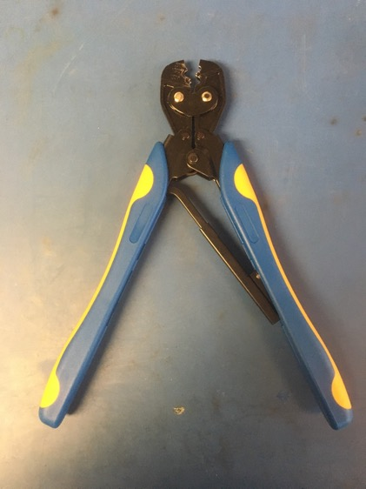
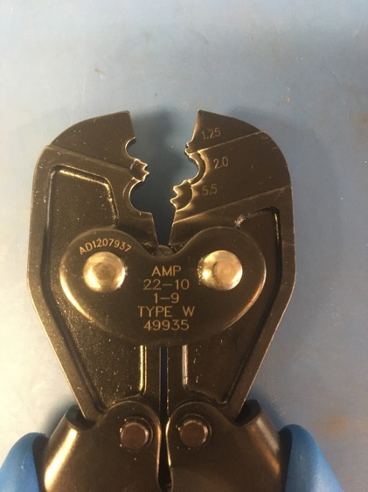
Fork & Eye Crimper

Slide 5
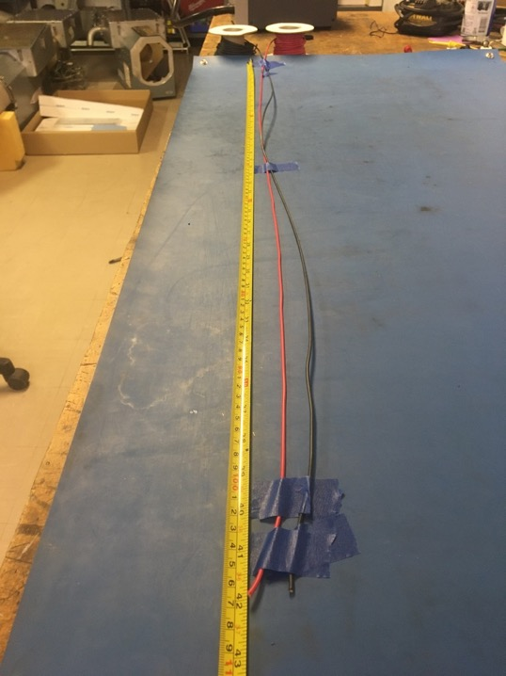
Measure out and cut 42 inches of red and black 14 awg wire.

Slide 6
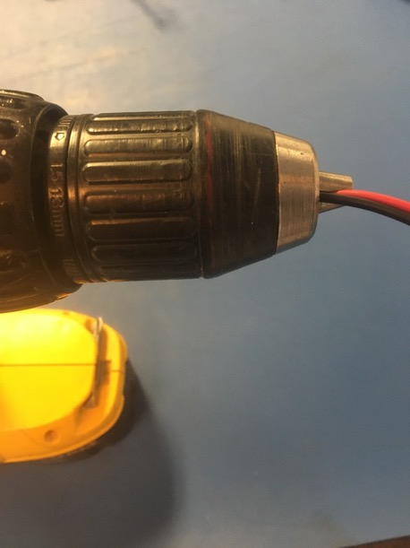
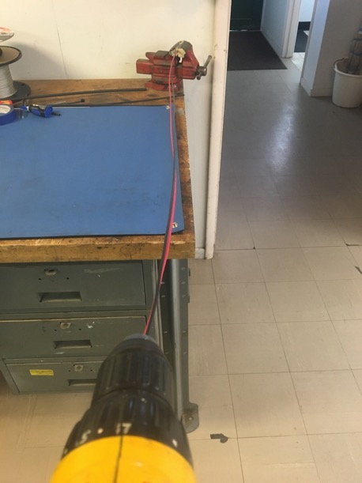
To make the twisted pair, line the vise with masking tape. Put one end of the red and black wires that were just cut into the vise and the other into the drill. Run the drill till the wires are sufficiently twisted (for reference see the next slide).

Slide 7
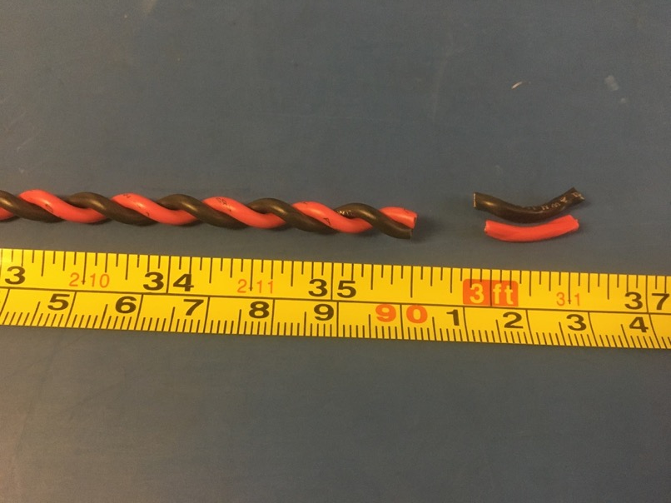
Trim the ends of the twist pair where they were in the vise and drill. Once trimmed they should measure about 35.5 inches.

Slide 8
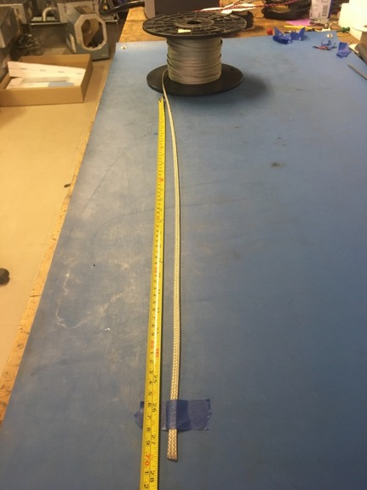
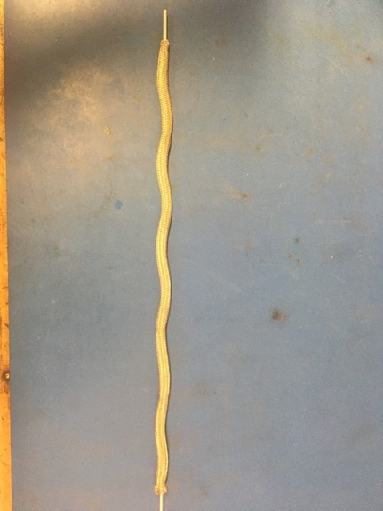
Measure out 27.5 inches of the .203 metal braid. Expand it using the metal rod.

Slide 9
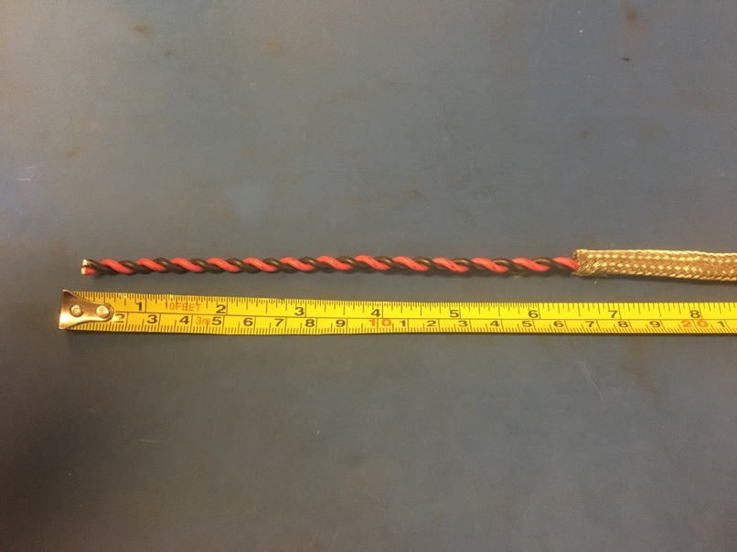
Put the twisted pair into the expanded metal braid. 6.5 inches of the twisted wires should stick out from the metal braid on one end.

Slide 10
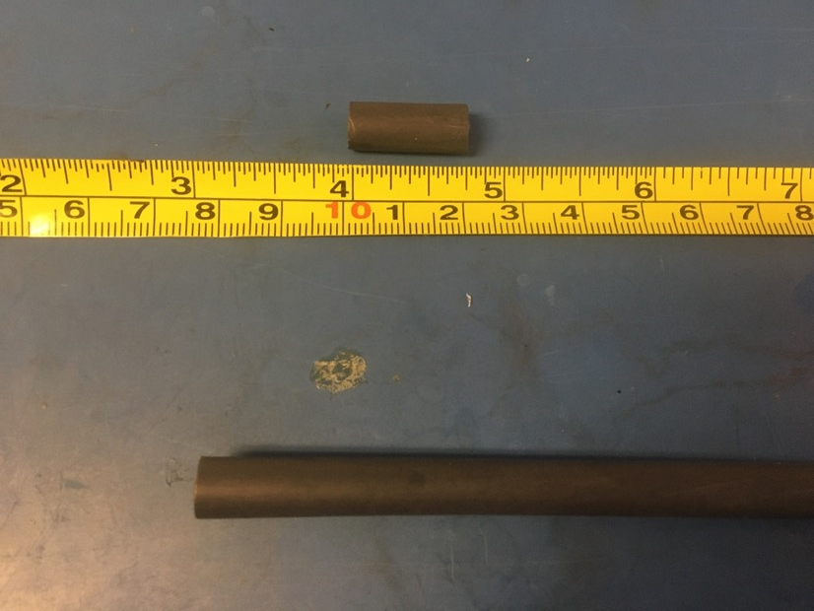
Measure out and cut two length of 6.4mm adhesive shrink tube each .75 inches long.

Slide 11
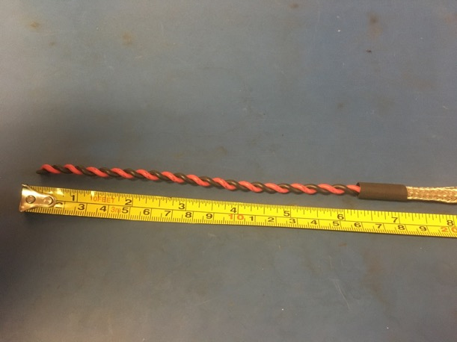
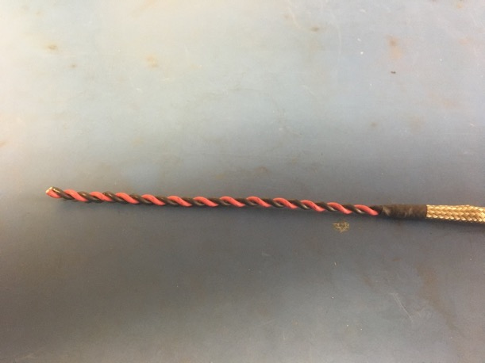
Put on one of the pieces of the shrink tube onto the end of the metal braid where the wires sticking out measured 6.5 inches. Place the shrink tube such that the metal braid ends midway through it. The wires should now measure 6.25 inches long. Apply the heat gun to the shrink tube.

Slide 12
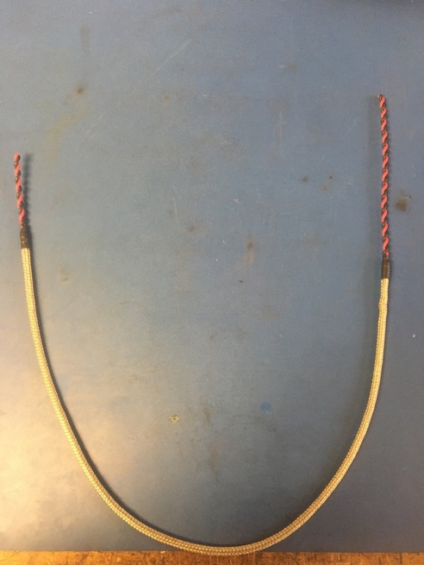
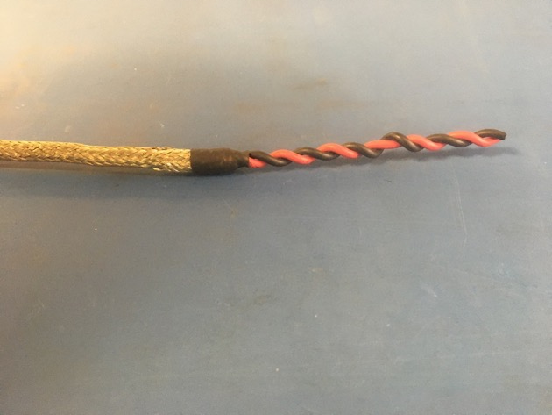
Repeat the process on the previous slide on the other end of the metal braid (though the wire does not need to be measured on this end). Thus far, the wire harness should appear as shown on the right.

Slide 13
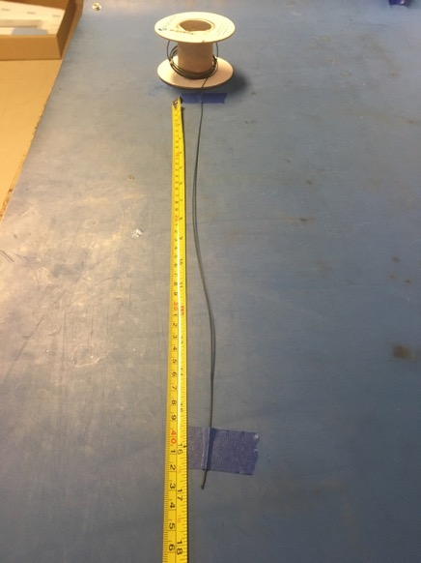
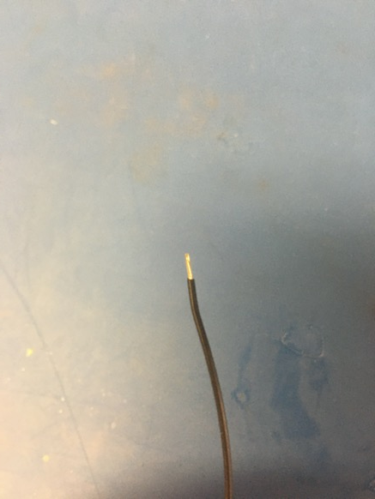
Measure out and cut 17 inches of black 24 awg wires. Strip 3-4mm of one end.

Slide 14
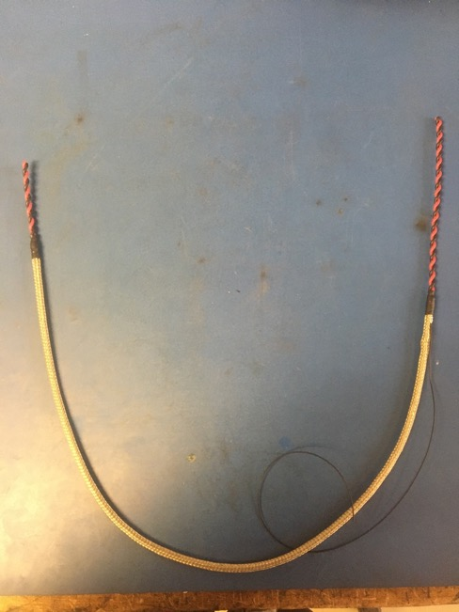
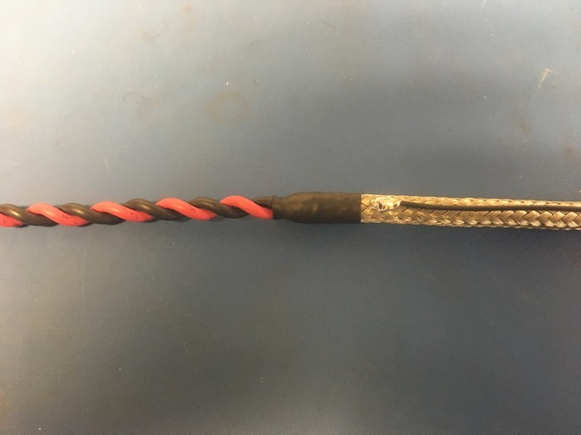
Solder the stripped end of the black wire onto the metal braid near the shrink tube joint where the longer end of the twisted pair sticks out (measured to be 6.25 inches previously). The black wire should be soldered so the that its length runs with that of the metal braid.

Slide 15
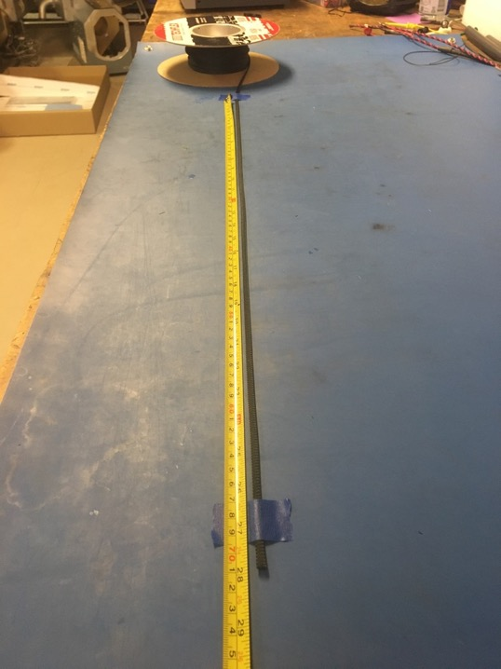
Measure out and cut 28 inches of 1/4th plastic braid.

Slide 16
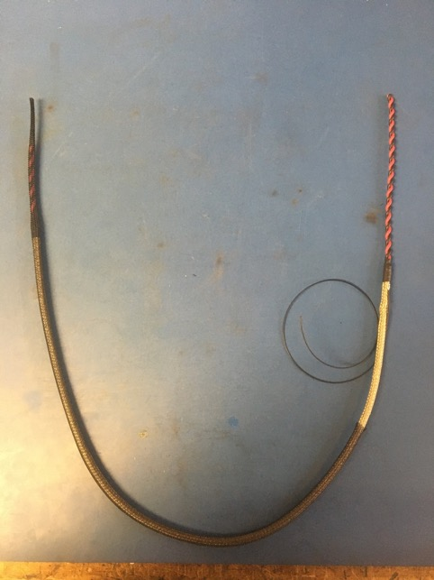
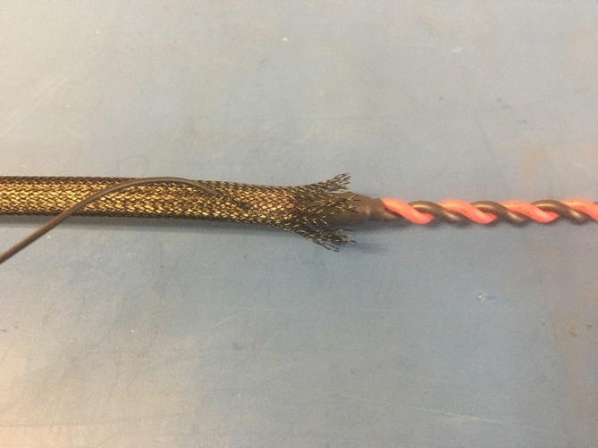
Put the plastic braid onto the wire harness. It is easier if it is put on the end of the harness without the ground wire first. Thread the ground wire through one of the holes in the plastic braid so it appears as shown of the right. The plastic braid should also end midway through the metal shrink tube joint below it.

Slide 17
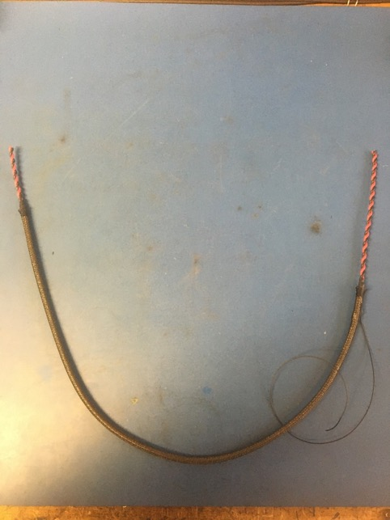
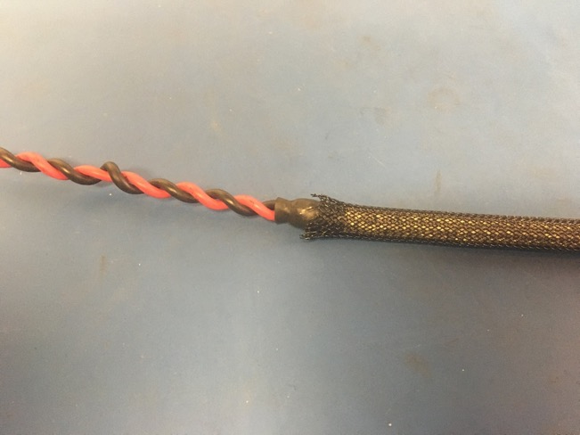
The plastic braid should end midway through the metal braid shrink tube joint on the other end of the harness as well.

Slide 18
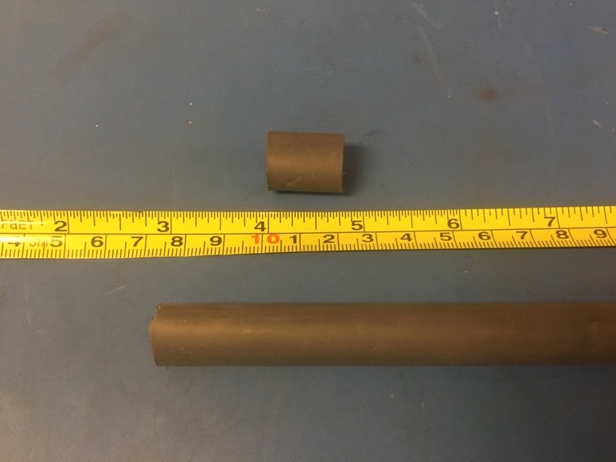
Measure out and cut one length of 12.7mm adhesive shrink tube that is .75in long.

Slide 19
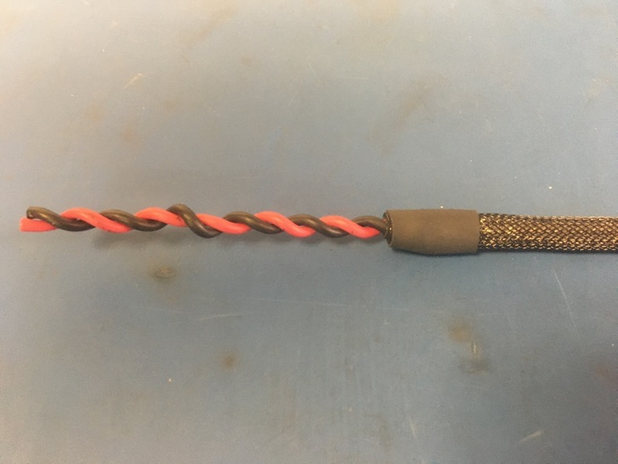
Place the piece of shrink tube onto the plastic braid end without the ground wire. The plastic braid should end midway through the piece of shrink tube. Apply the heat gun.

Slide 20
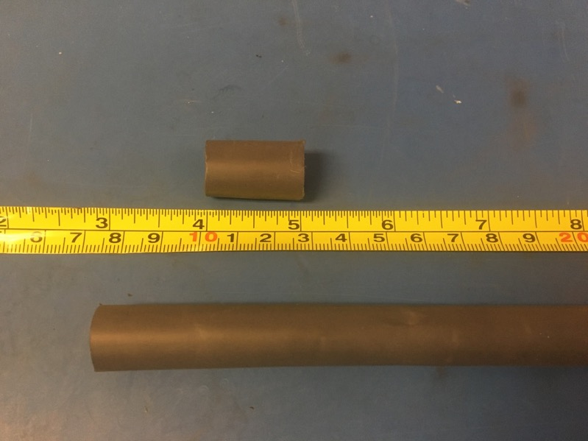
Measure out and cut one length of 12.7mm adhesive shrink tube that is 1in long.

Slide 21
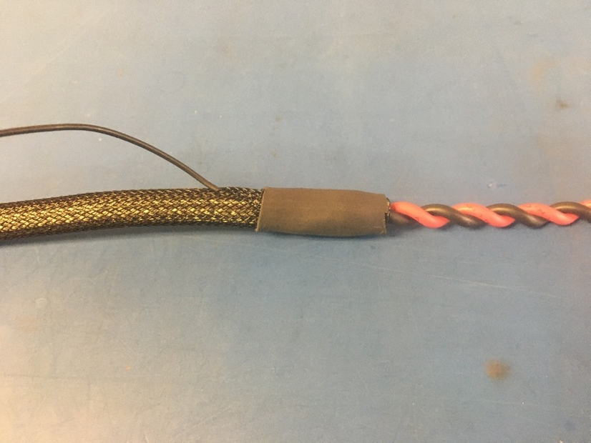
Place the piece of shrink tube onto the plastic braid end with the ground wire. The shrink tube should be placed such that it covers the solder joint and the length of shrink tube beneath. Apply the heat gun.

Slide 22
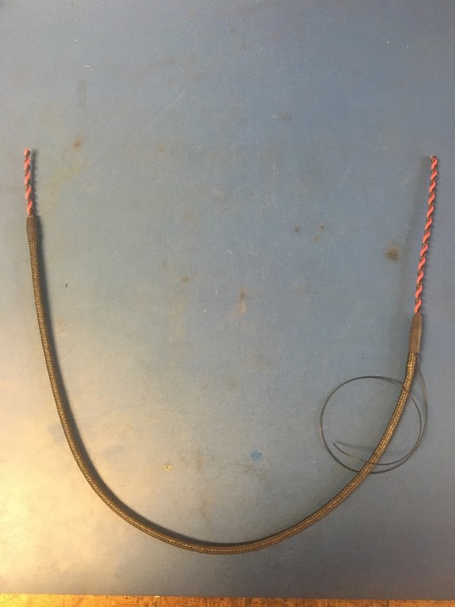
Thus far, the wire harness should look as shown.

Slide 23
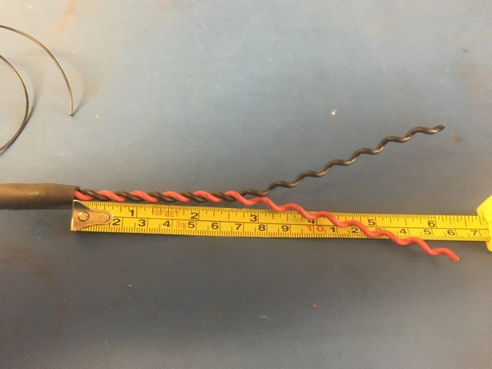
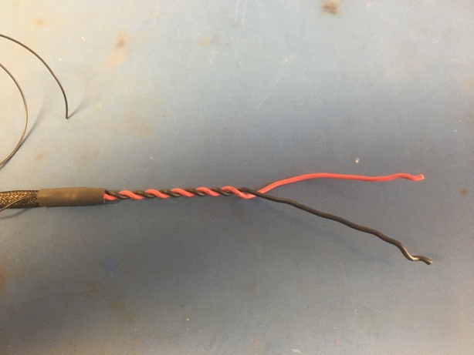
Take the ground wire end of the wire harness and untwist it until about 2.5 inches of it remains twisted. Straighten out the lengths that were untwisted.

Slide 24
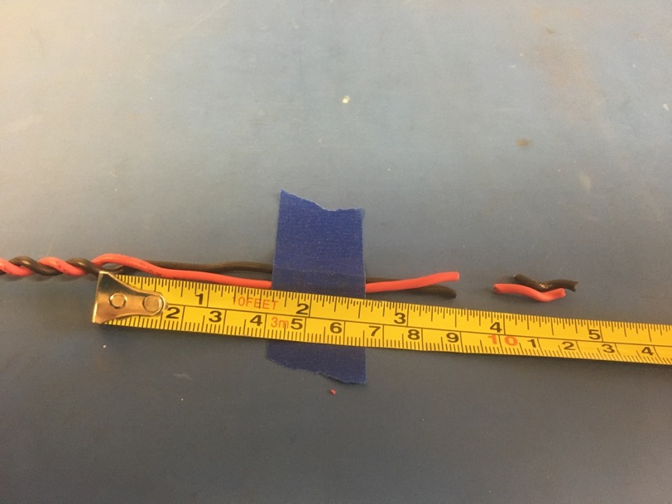
Measure the lengths of wire that was untwisted and cut it to be 3.5 inches long.

Slide 25
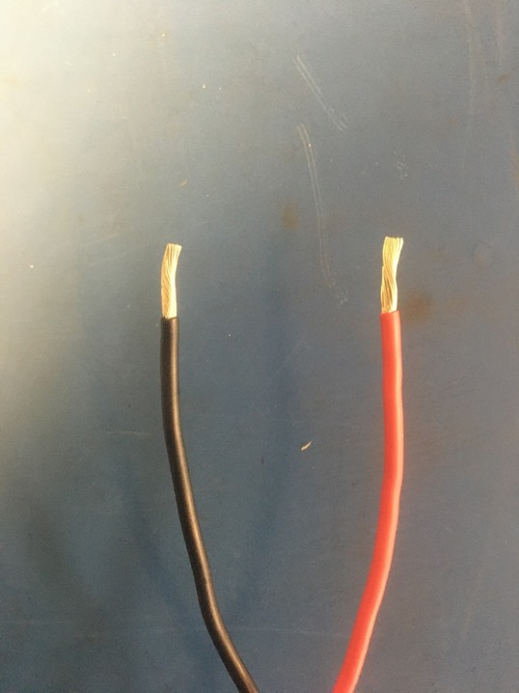
Taking the two ends of wire that were just trimmed, strip about blah mm of isolation off.

Slide 26
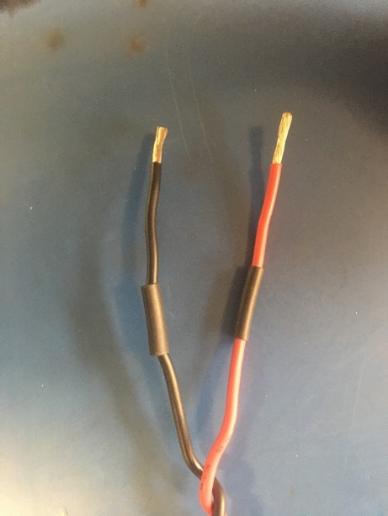
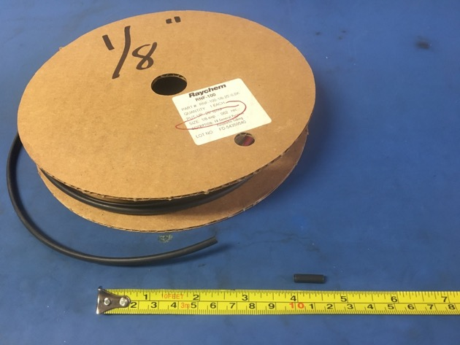
Measure out and cut two lengths of 1/8th non-adhesive shrink tube that are each .5 inches long. Put one length of shrink onto each of the stripped wire ends.

Slide 27
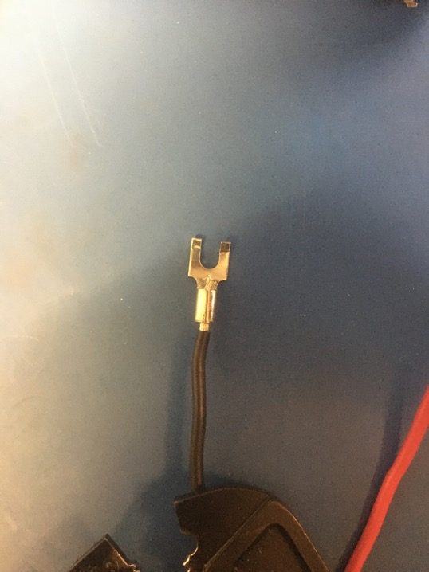
Place the size 6 forks onto each of the stripped wire ends as shown. Exposed wire should be visible above and below the forks’ tube.

Slide 28
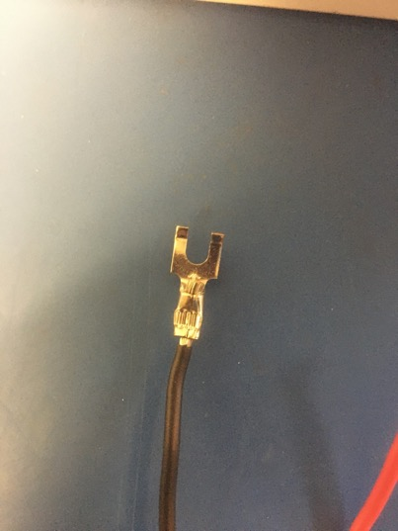
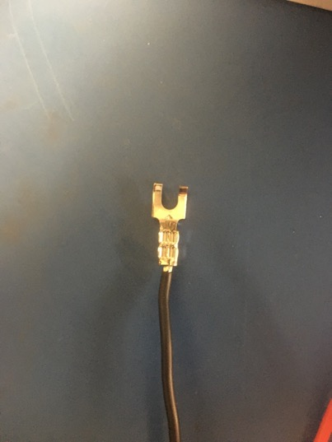
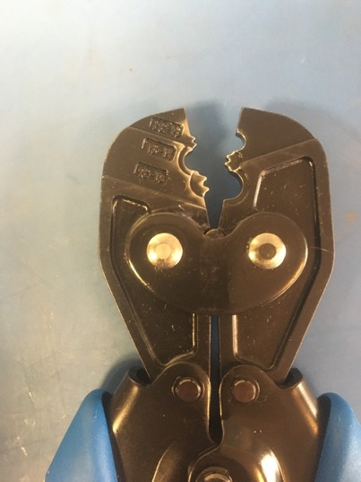
Crimp the forks using the 16-10 awg slot in the crimper. Each fork needs to crimped twice: one above the other as shown in the middle photo.

Slide 29
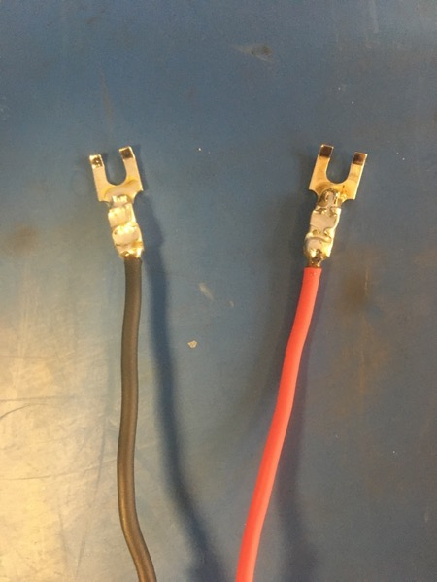
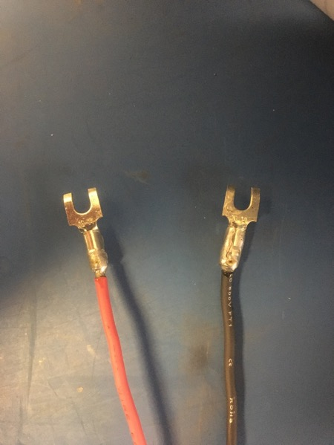
Solder the crimped joints of the forks. The solder should cover all the exposed wire both above and below the forks’ crimped joints. Do not forget about the exposed wire below the crimped joints on the reverse side of the forks as well. Try to be fast as the shrink tube will shrink in the incorrect place if the heat travels down the wire to far.

Slide 30
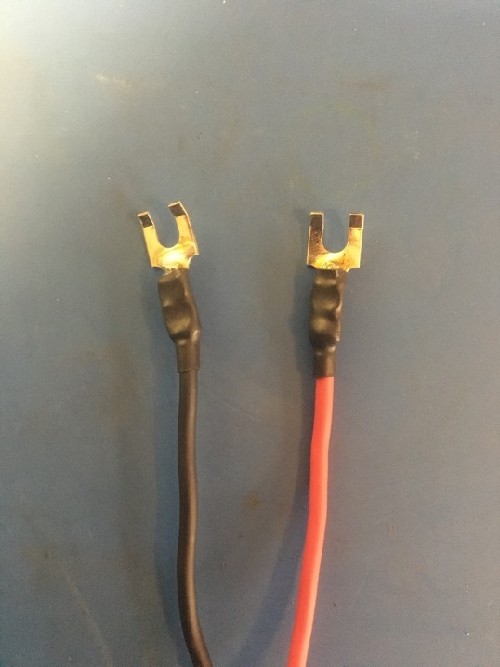
Move the pieces of shrink tube on the wire to cover the crimped/soldered joints. Apply the heat gun.

Slide 31
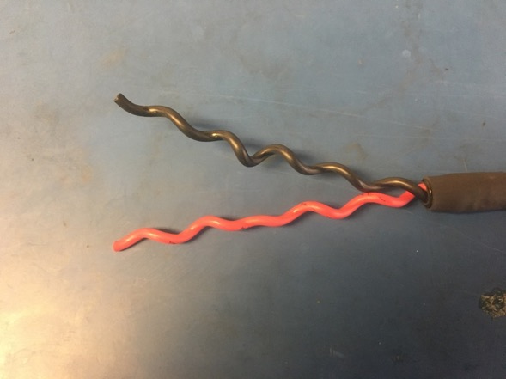
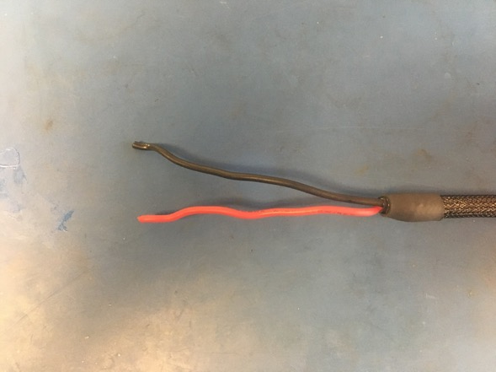
Take the other end of the wire harness and completely untwist the wires and straighten them.

Slide 32
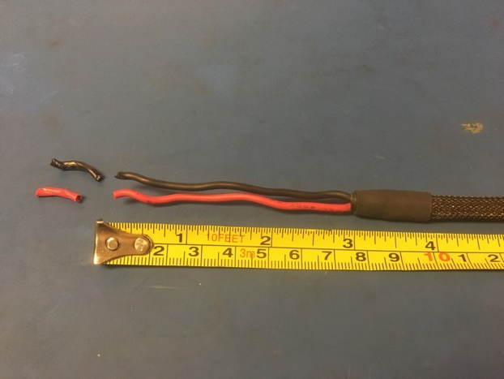
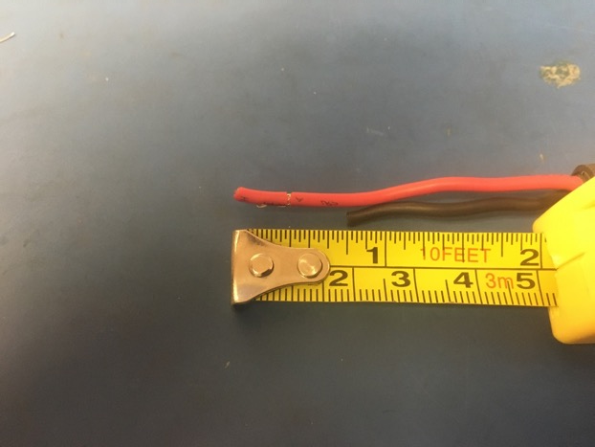
Measure the lengths of wire and trim them to be 3 inches long. Then cut the black wire so that it is .75 inches shorter than the red wire.
retake

Slide 33
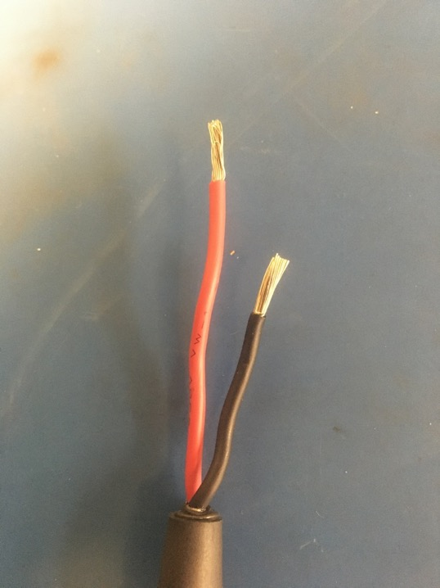
Taking the two ends of wire that were just trimmed, strip about blah mm of isolation off.

Slide 34
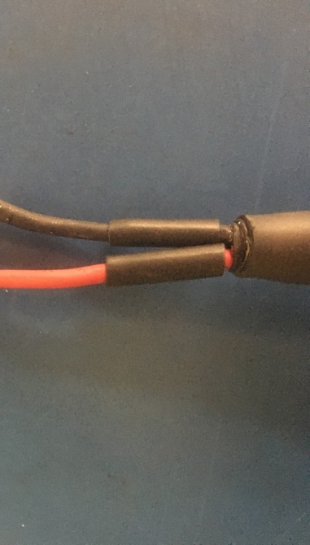
Measure out and cut two lengths of 1/8th non-adhesive shrink tube that are each .5 inches long. Put one length of shrink onto each of the stripped wire ends.
retake

Slide 35
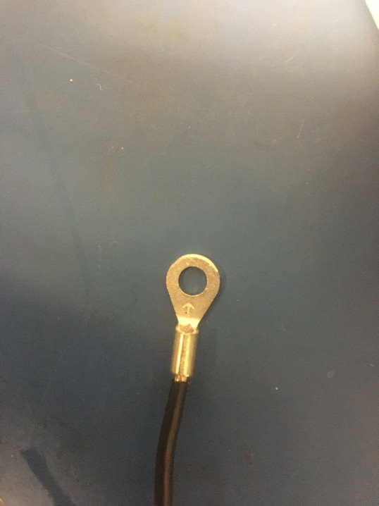
Place the size 8 eyes onto each of the stripped wire ends as shown. Exposed wire should be visible above and below the eyes’ tube.

Slide 36



Crimp the eyes using the 18-14 awg slot in the crimper. Each eye needs to crimped twice: one above the other as shown in the middle photo.

Slide 37

Solder the crimped joints of the eyes. The solder should cover all the exposed wire both above and below the eyes’ crimped joints. Do not forget about the exposed wire below the crimped joints on the reverse side of the eyes as well. Try to be fast as the shrink tube will shrink in the incorrect place if the heat travels down the wire to far.
Show backside

Slide 38

Move the pieces of shrink tube on the wire to cover the crimped/soldered joints. Apply the heat gun.

Slide 39

Wire harness complete! The ground wire will be given and tip later.

